Slide 1
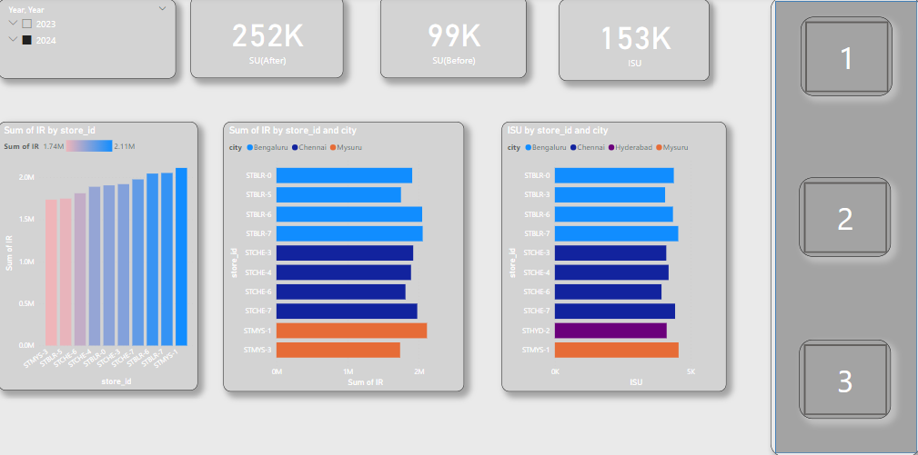

Slide 2
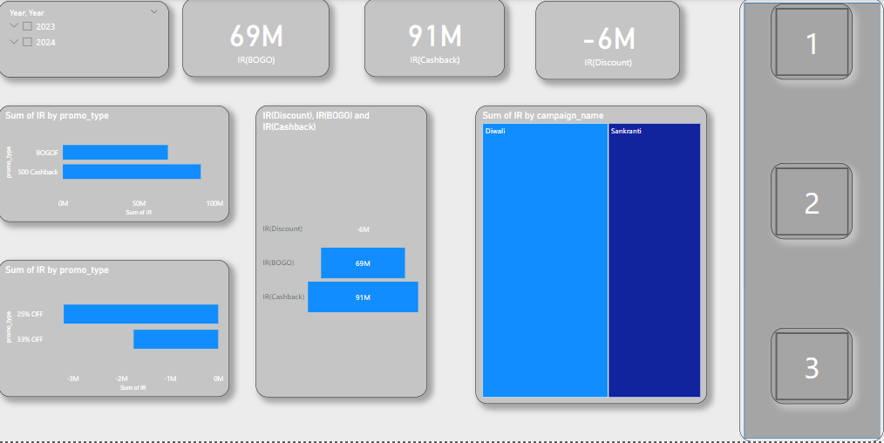

Slide 3
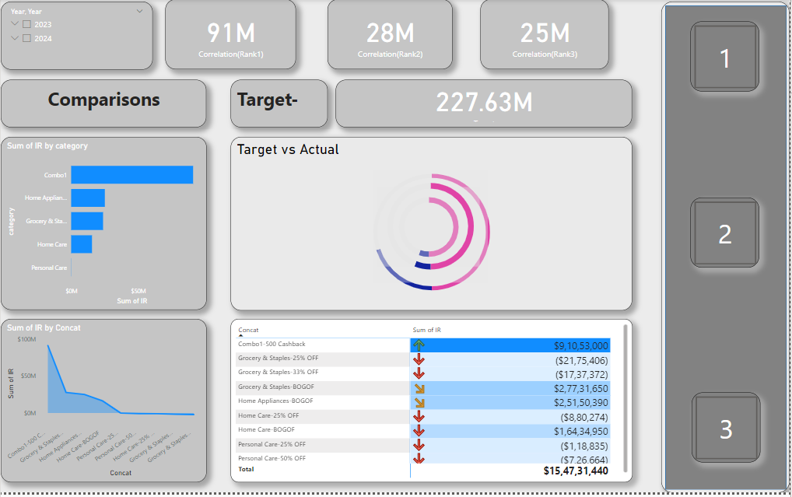

Slide 4
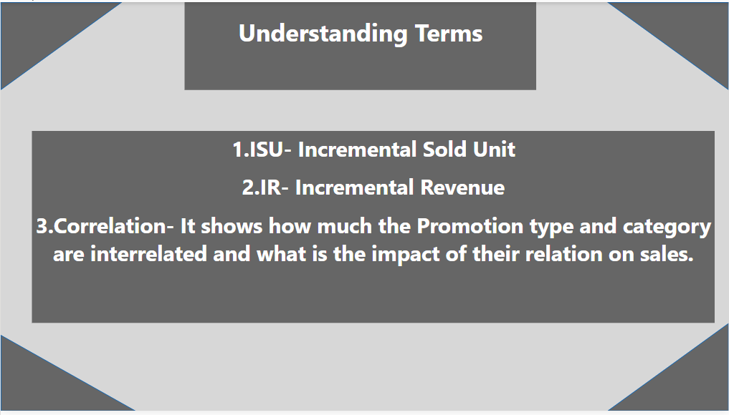

Slide 5

C9 RESUME CHALLENGE Ad-Hoc Requests
RANIT GHATAK

Slide 6
SQL query1 Generate a report that shows Products that have base price less than 500 and promo type is-BOGOF
RANIT GHATAK

Slide 7



Query1-Find products which have base price>500 and sold under promo type – BOGOF.

Slide 8
SQL query2 Create a report that provides City wise store count
RANIT GHATAK

Slide 9
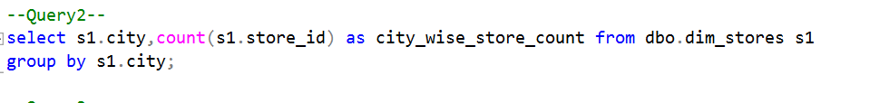
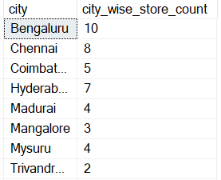
Query 2-City wise store count

Slide 10
SQL query3 Create a report that displays before and after revenue for each campaign
RANIT GHATAK

Slide 11
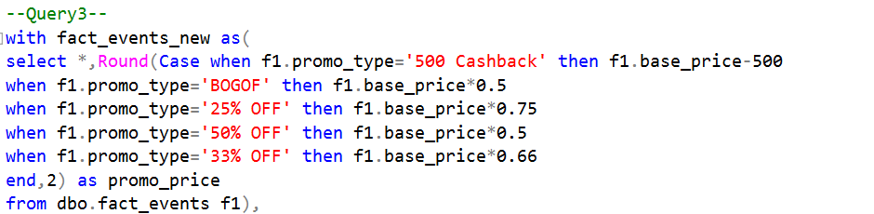
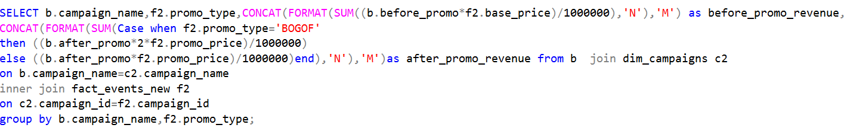
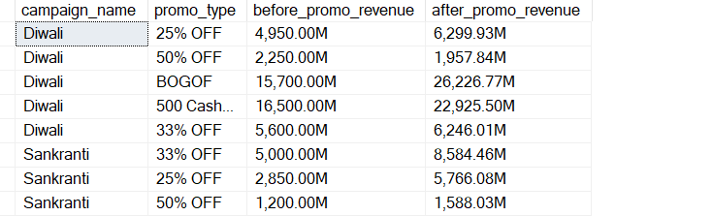
Query 3-Revenue comparison before and after Promotion

Slide 12
SQL query4 Provide a report That Calculates ISU% for each category across campaigns
RANIT GHATAK

Slide 13
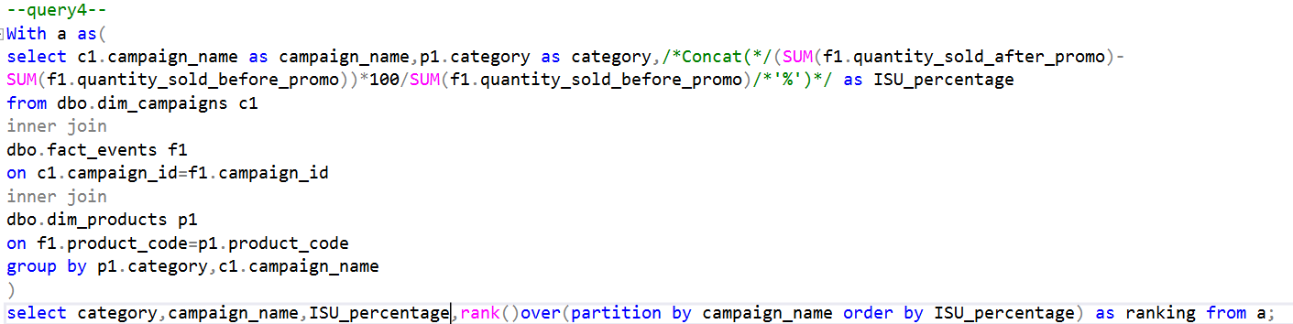
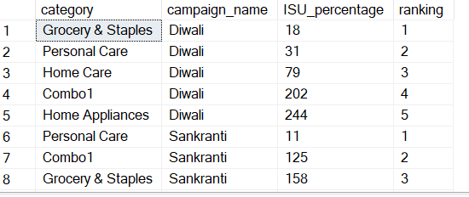
Query 4-Ranking Categories as per Campaign name and ISU%

Slide 14
SQL query5 Create a report featuring top 5 Products ranked by IR
RANIT GHATAK

Slide 15
